Slide 1
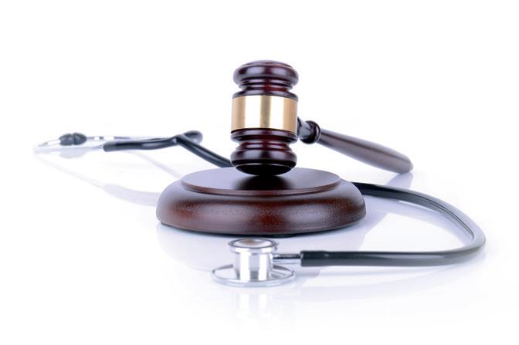

GENERAL DATA PROTECTION REGULATION 2016 (GDPR)
An Overview
Shanee Baker - Director/Lawyer, LMC Law

Slide 2

WHAT IS GDPR?
Part of a wider package of reform in respect of data protection: new Data Protection Act, new IG Toolkit, new national data opt-out developed by NHS Digital.
Effective 25th May 2018
Applies (where GPs are concerned) mainly to personal and sensitive data they hold on patients: no real change
BUT… it imposes a few more obligations on GPs and healthcare organisations where compliance is concerned
The Regulations define “special category” data which will need more safeguarding because it is more sensitive - GPs will be subject to more stringent rules because of healthcare data they hold

Slide 3
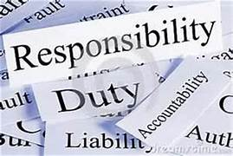
CURRENT OBLIGATIONS
Don’t panic – you have time to show compliance, this is an ongoing process and it won’t end on 25th May:
If you handle patient sensitive information you will have to protect that
Only collect for a specific purpose
Keep it secure
Ensure it is relevant and updated
Only hold as much as you need

Slide 4
GPs AS DATA CONTROLLERS
What is a Data Controller?
Person or organisation determining “the purposes and means of the processing of personal data” - GPs are Data Controllers of patient information
A Data Processor “processes personal data on behalf of the data controller” – GPs can also be Data Processors
The legal responsibility is on the Data Controller to ensure that any processing of the data they collect by any third parties is controlled and compliant
There should be a contract in place between the Data Controller and Data Processor

Slide 5
GPs AS DATA CONTROLLERS continued
Obligation of the GP Data Controller is to ensure access to data is secured and only accessed by staff providing direct care to an individual patient - to meet this obligation Practices must ensure, for example: confidentiality clauses are written into staff contracts
Ultimately as Data Controllers, GP Practices have responsibility for handling all requests for access to data and even if they delegate responsibility they are still responsible.
NOTE: GPs need to establish both a lawful basis and a special category condition to process special category data.

Slide 6
LAWFUL BASIS FOR PROCESSING
Need to identify the lawful basis for processing. This can include:
Consent - article 6.1(a):
You need to have clear consent, not implied – so patients have to tick a box if that’s how you are obtaining consent
If verbal, then note it
Think about your registration of new patients
You need separate consent for different things
Tell patients how to withdraw consent
Record consent properly
Review consent regularly
Contract – article 6.1(b):
The processing is necessary for a contract you have with the individual

Slide 7
LAWFUL BASIS FOR PROCESSING continued
Legal Obligation – article 6.1(c):
The processing is necessary to comply with a legal obligation
Vital Interests – article 6.1(d):
The processing is necessary to protect someone's life
Public Task – article 6.1(e):
The processing is necessary to perform a task in the public interest or for your official functions, and the task or function has a clear basis in law. NOTE: this is the likely lawful basis that GPs will use to process: NHSE powers to commission health services under the NHS Act 2006 together with powers to delegate to CCGs

Slide 8
ESTABLISHING A SPECIAL CATEGORY CONDITION
GPs will also have to establish a “Special Category Condition” for processing as follows under Article 9:
9.2(a) – the data subject has given explicit consent to the processing of those personal data for one or more specified purposes…
9.2(b) – processing is necessary for the purposes of carrying out the obligation and exercising specific rights of the controller or of the data subject in the field of employment and social security…
9.2(c) – processing is necessary to protect the vital interests of the data subject or any other natural person where the data subject is physically or legally of incapable of giving consent.

Slide 9
ESTABLISHING A SPECIAL CATEGORY CONDITION continued
9.2(d) – processing is carried out in the course of its legitimate activities with appropriate safeguards by a foundation, association or any other not for profit body with a political, philosophical religious or trade union aim and on condition that the processing relates solely to the members or to former members of the body or to persons who have regular contract with it in connection with its purposes and that the personal data are not disclosed outside that body without the consent of the data subject.
9.2(e) – processing relates to personal data which are manifestly made public by the data subject

Slide 10
ESTABLISHING A SPECIAL CATEGORY CONDITION continued
9.2(f) – processing is necessary for the establishment, exercise or defence of legal claim or wherever courts are acting in their judicial capacity
9.2(g) – processing is necessary for reasons of substantial public interest on the basis of union or member state law which shall be proportionate to the aim pursued…
9.2(h) – processing is necessary for the purposes of preventative or occupational medicine, for the assessment of the working capacity of the employee, medical diagnosis, the provision of health and social care or treatment or the management of health or social care systems and services on the basis of union or member states law or pursuant to contract with a health professional and subject to the condition and safeguards referred to in paragraph 3 (common law duty of confidentiality)

Slide 11
ESTABLISHING A SPECIAL CATEGORY CONDITION continued
9.2(i) – processing is necessary for the reason of public interest in the area of public health…
9.2(j) – processing is necessary for archiving purposes in the public interest, scientific or historical research purposes…

Slide 12
DATA PROTECTION OFFICER (DPO)
GPs may be classed as public authorities under the GDPR (similar to FOIA)
If so, then highly likely you will need a DPO (a named person) – you may have someone already (Caldicott Guardian)
Especially if you carry out large scale processing of special category data
DPO will need to be trained, can be an employee, cannot be conflicted – this essentially means cannot determine purpose, use, or management (governance role)
May not therefore be a Partner
Can act for several practices
If a federation then DPO reports to Board

Slide 13
DATA PROTECTION OFFICER (DPO) continued
A DPO is protected – can’t remove them if they report you to the ICO
Particular skill set: requires knowledge of the GDPR and other legislation around data protection
Needs to understand the practice and the information that the practice handles
Needs to be aware of data security
Needs to conduct audits and monitor compliance

Slide 14
DATA PROTECTION IMPACT ASSESSMENTS (DPIA)
Also known as PIAs
Probably the duty of the DPO
You will need to carry out this assessment when you are processing large scale special category data where this is likely to result in high risk to rights and freedoms of individuals e.g. extended hours hubs, clinical pharmacist agreements, mergers/super-partnerships and provision of other commissioned services
This is to assist organisations in identifying their DP obligations and meet the requirements of privacy for the patient
See ICO code of practice for conducting PIAs

Slide 15

PRIVACY NOTICE
Sometimes referred to as “Fair Processing Notices” - Very important to get this right
It needs to be simple, clear and easy to understand
It needs to state:
Contact details of Practice as the data controller
Contact details of DPO
What personal information you hold (usually patient medical data)
Purpose of holding it (could be for a variety of reasons but essentially for medical care) - need to state here the legal basis and special category condition
Other legal bases if processing is for reasons other than direct care
cont…

Slide 16
PRIVACY NOTICE continued
What you plan to do with it and how you use it
Whether you are collecting for others (e.g. the commissioner)
Whether there are other data controllers and processors
Whether you are creating new personal information (all the time)
Retention period
Right to make a complaint to ICO
You can’t charge for it!

Slide 17
PRIVACY NOTICE continued
You may need a separate one for children and they need it simplified says the ICO
Don’t forget your employees: they may need a separate one. e.g. workflow minimum data set as well as holding personal information on them
The employee privacy policy should be relatively straightforward

Slide 18
A FEW MORE RULES
Patients have rights of access - but the GP may redact the file online by coding as you enter information on third parties
Can’t provide access unless you have removed references to third parties
Beware letters and documents that are scanned onto the record before GP has sight
Patients can request amendment, correction, erasure – but no absolute right to be forgotten
Right of erasure does not apply to a persons health record or care record or for public health or scientific research purposes

Slide 19
SUBJECT ACCESS REQUESTS (SAR)
SAR – time to comply shortened to a month (was 40 days before)
Can extend to 2 months if complex, or numerous requests
No fee – but can charge if unfounded, excessive, or repetitive
Fee based on admin costs
Nasty solicitor requests: manage these carefully!
Beware CQC inspections re compliance

Slide 20
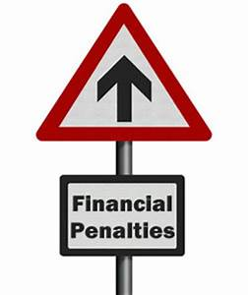
BREACH/PENALTIES
Notify the ICO within 72 hours if you are aware of any breach
Notify serious breaches without delay!
Notify the individual directly
Fine between 2% of annual turnover or 10 million Euros (whichever is higher)
For really serious breaches 4% of annual turnover or 20 million Euros (whichever is higher)
Can also include warnings, bans on processing
Fines and penalties meant to be proportionate and dissuasive

Slide 21
SO, WHAT DO YOU NEED TO DO?
GPs, as Data Controllers, are accountable under GDPR and must actively demonstrate compliance (will likely be done via DPO), therefore must:
document flows of data from the practice;
have internal data protection policies/procedures in place;
Carry out DPIA when engaging in new data sharing arrangements or where new technologies will be used or any other types of processing resulting in high risk to data subjects;
train staff re. compliance – be aware of security of data and access requirements re any volunteers/work placement students;
Provide the contact details of the DPO to patients;
cont…

Slide 22
SO, WHAT DO YOU NEED TO DO? continued
Have a robust privacy policy in place;
Ensure your DPO (or current Caldicott Guardian) is properly trained and not conflicted;
Put leaflets and posters in surgeries so that patients are reasonably informed;
Update your website;
Make sure you review your new current registration processes;
Some good news… if you are performing well in IG toolkit this is a good start. 2016/17 IGT does not specifically tackle GDPR requirements and is in the process of being updated but is a good starting point to show compliance;
You need to be able to demonstrate to the ICO that you have made all reasonable efforts to comply with GDPR, including using best practice procedures, e.g. PIA

Slide 23
OTHER USEFUL INFORMATION
Additional bespoke guidance
DPO
Training
Privacy Policy
Contact details:
shaneebaker@lmclaw.co.uk
clairepye@lmclaw.co.uk
niobe.menelaou@lmclaw.co.uk
Tel: 07788 313582

